Slide 1
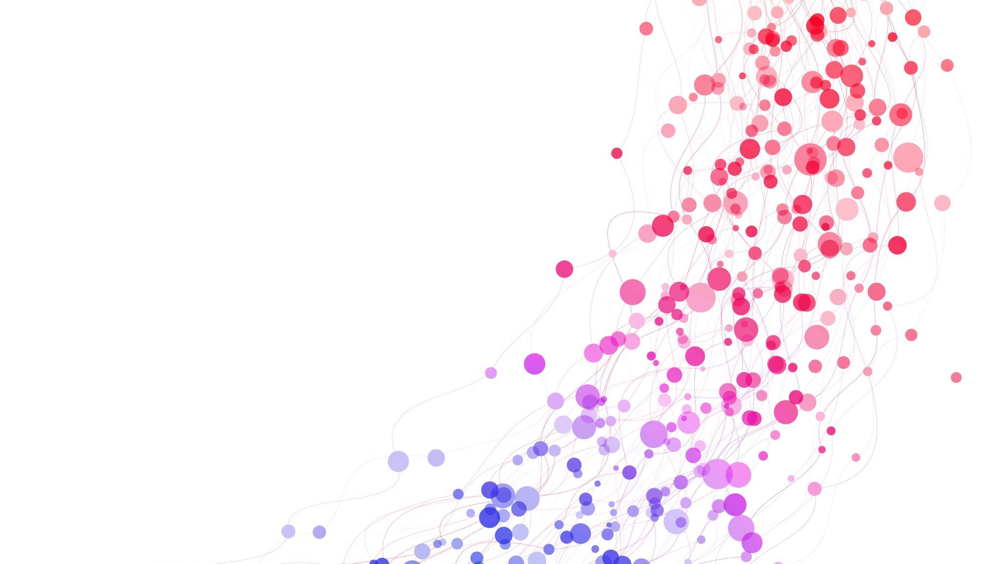
Lab 2
Team 5:
KUS AHMET BUGRA
LEE TENG YEE SHERILYN
LEE ZHENG JIE

Slide 2
Content
(a) Suppose the input graph G = (V, E) is stored in an adjacency matrix and we
use an array for the priority queue. Implement the Dijkstra’s algorithm using this
setting and analyze its time complexity with respect to |V| and |E| both
theoretically and empirically.
(b) Suppose the input graph G = (V, E) is stored in an array of adjacency lists and
we use a minimizing heap for the priority queue. Implement the Dijkstra’s
algorithm using this setting and analyze its time complexity with respect to |V|
and |E| both theoretically and empirically.
(c) Compare the two implementations in (a) and (b). Discuss which implementation
is better and in what circumstances.

Slide 3
Part (A)

Slide 4
Algorithm Setup
• Input Graph: G = (V, E)
• Representation: Adjacency Matrix (|V| × |V|)
• Priority Queue: Array-based implementation
• Goal: Compute the shortest path from a source vertex to all others

Slide 5
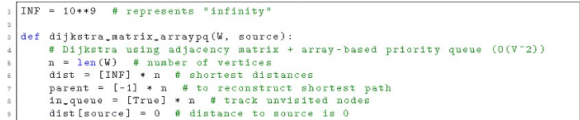
Initialization
Set an infinity value.
Initialize arrays: distance, parent, in_queue.
Source vertex starts at 0, others at infinity.

Slide 6
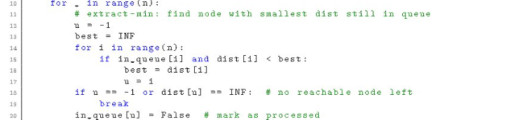
Finding Minimum
Algorithm runs once per vertex.
In each round, find the smallest distance by scanning all vertices → O(V).
Uses an array (not a heap).

Slide 7
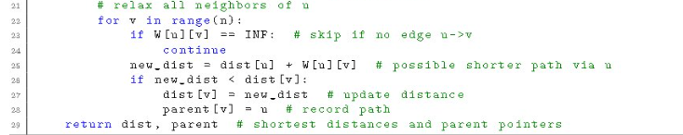
Relaxation & Complexity
Relax all neighbors using adjacency matrix.
Checks every vertex in the row, even without edges.
Each round does O(V) work × V rounds → O(V²).
Runtime depends on V, not E.

Slide 8
Theoretical Analysis – Array pq
Each iteration selects the vertex with the smallest distance by scanning all vertices → O(|V|)
For each selected vertex, all possible |V| neighbors are checked in the adjacency matrix → O(|V|)
The main loop repeats for all |V| vertices → Total: O(|V|²)
Since every vertex pair is checked regardless of edge existence, |E| does not affect the runtime
Space requirement: adjacency matrix → O(|V|²)
Efficient for dense graphs, inefficient for sparse ones.

Slide 9
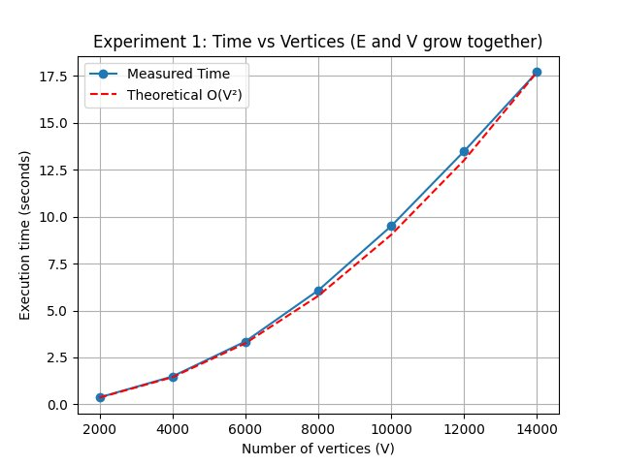
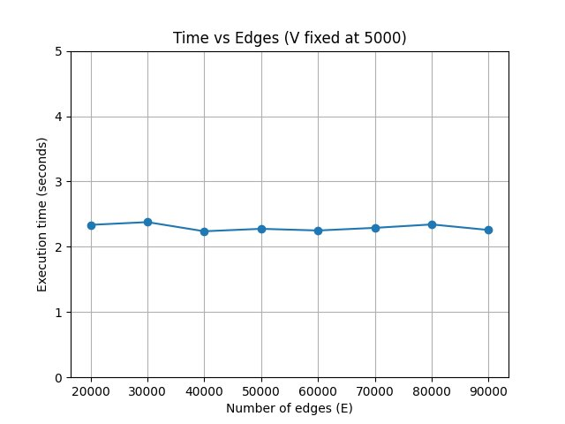
Empirical Results – Array PQ

Slide 10
Final Analysis & Validation
Theory: Time complexity = O(|V|²) using adjacency matrix + array PQ.
Reason: Each iteration scans all vertices for extract-min and relaxation.
Observation: Runtime grows quadratically as |V| increases.
Validation: Empirical results match theoretical expectation.
Conclusion: Simple but slow — good for dense graphs, weak for sparse graphs.

Slide 11
Part (B)

Slide 12
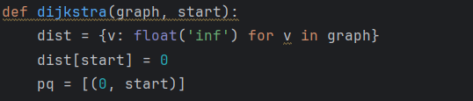
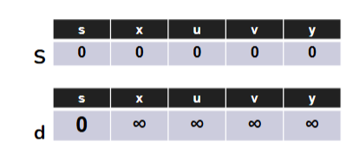
Code analysis (Theoretical)
Initialization
setting up the distances for all vertices
All distances are initially set to ∞ (unknown), except the start vertex, which is set to 0
A min-heap (priority queue) is initialized to keep track of the vertex with the current smallest tentative distance.
Assigning a value per vertex is a constant-time operation, thus O(|V|)

Slide 13
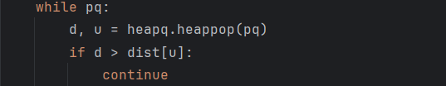
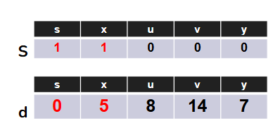
Code analysis (Theoretical)
Vertex Heap Pop
At each step, we pick the vertex with the smallest tentative distance from the min-heap.
focus on the closest vertex to finalize its shortest path.
Once a vertex is popped, its shortest distance is finalized, and we then check its neighbors.
Each pop from a min-heap is O(log |V|).
We do this once per vertex, since a vertex is popped exactly when its shortest distance is finalized: ∣V∣×O(log∣V∣)=O(∣V∣log∣V∣)
Thus, O(|V| log |V|)

Slide 14
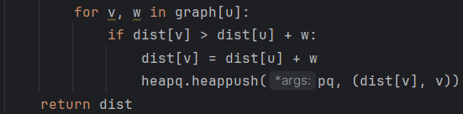
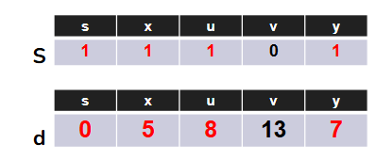
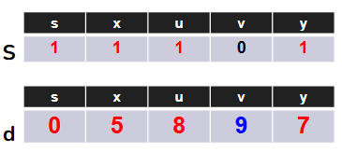
Code analysis (Theoretical)
Update distance in edges of vertices to its neighbour
After popping a vertex, we look at all its neighbors.
If we find a shorter path through the popped vertex, we update the neighbor’s distance and push it into the heap.
Each edge may cause a heap push, which costs:
O(log |V|).
Across all edges, we perform this atmost once per edge:
∣E∣×O(log⁡∣V∣) = O(∣E∣log∣V∣)
Thus, O(|E| log |V|)

Slide 15
Code analysis (Theoretical)
Total Time Complexity:
O(|V|) + O(|V| log |V|) + O(|E| log |V|) = O[(|V| + |E|) log |V| ]
Notes:
O(|V|) is absored into O(|V| log |V|)

Slide 16
Min Heap Priority Queue
What a Heap Queue?
A heap queue (also called a priority queue) is a special data structure that allows quick access to the smallest (min-heap) or largest (max-heap) element.
Why use Min-Heap?
Provides an efficient way to implement priority queues using heaps:
  At each step, Dijkstra needs the vertex with the smallest tentative distance.
  Without a heap, we’d scan all |V| vertices → O(|V|) per extraction.
  With a min-heap,The smallest-distance vertex is always at the top → heappop() takes O(log |V|) and since we extract each vertex exactly once, the totalcost is: ∣V∣×O(log∣V∣) = O(∣V∣log∣V∣)
Helps maintain a list in heap order with minimal code and high performance.
Notes:
A heap queue (also called a priority queue) is a special data structure that allows quick access to the smallest (min-heap) or largest (max-heap) element.
Provides an efficient way to implement priority queues using heaps.
Helps maintain a list in heap order with minimal code and high performance.
With a Min-Heap (Priority Queue)
When we replace that array with a min-heap, we get two key improvements:
Extract-Min (Heap Pop)
Instead of O(|V|) linear search, heappop() takes O(log |V|).
Done |V| times → O(|V| log |V|) total.
Decrease-Key (or Push)
Each time we relax an edge, we push the new distance into the heap → O(log |V|) per operation.
Done up to |E| times → O(|E| log |V|) total.
✅ Thus, the total becomes:
O((∣V∣+∣E∣)log⁡∣V∣)O((|V| + |E|) \log |V|)O((∣V∣+∣E∣)log∣V∣)

Slide 17
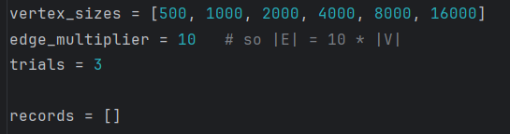
Preparing the Empirical analysis
Why Edge Multiplier is 10?
a middle ground for sparse graphs
ensures each vertex has multiple neighbors, making Dijkstra’s algorithm do a meaningful number of relaxations.
exact multiplier (like 10) doesn’t affect the algorithm’s asymptotic complexity

Slide 18
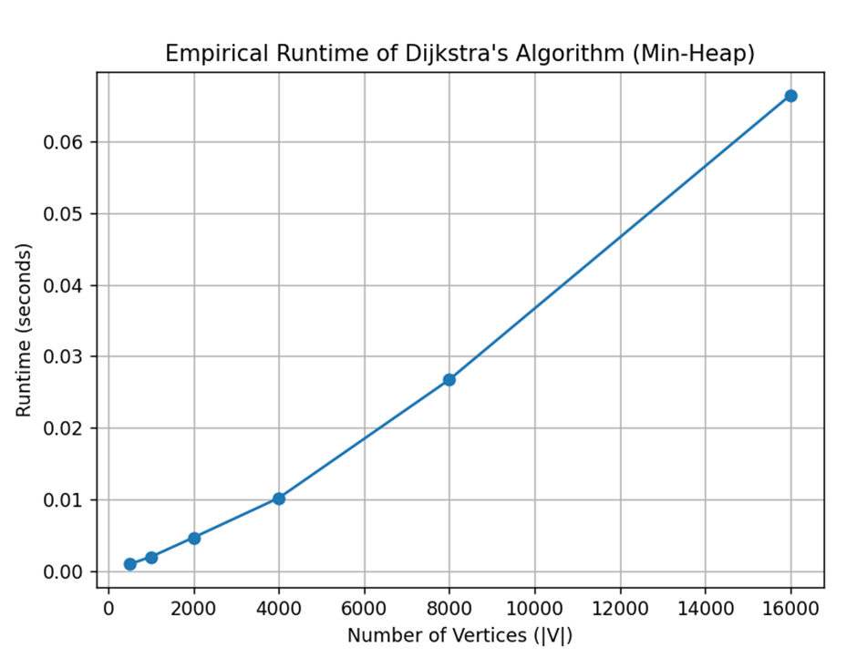
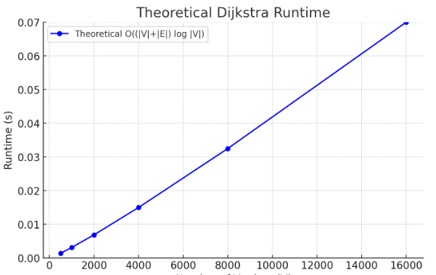
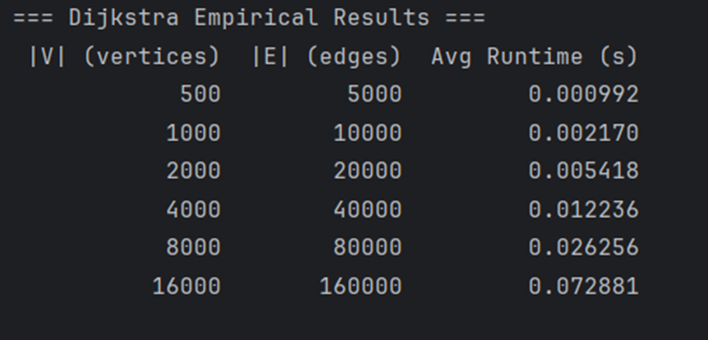
Empirical Graph analysis

Slide 19
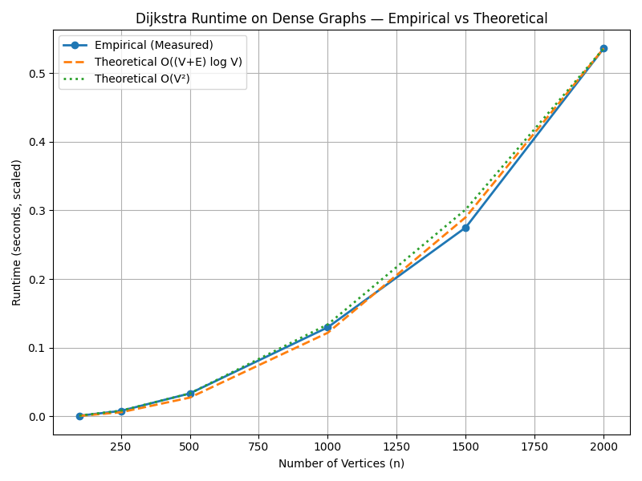
Empirical Graph analysis
Dense Graph

Slide 20
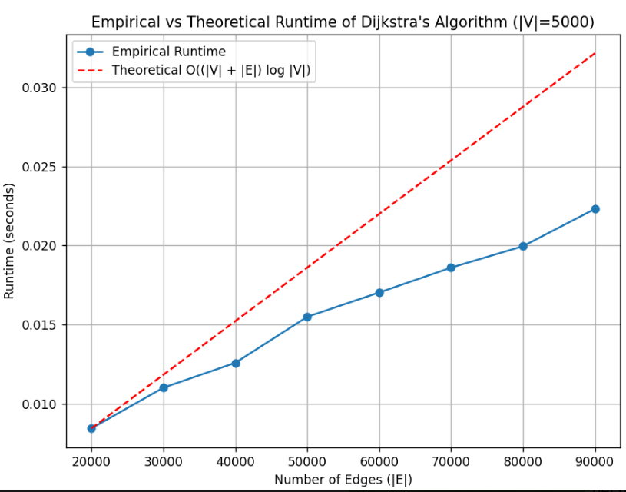
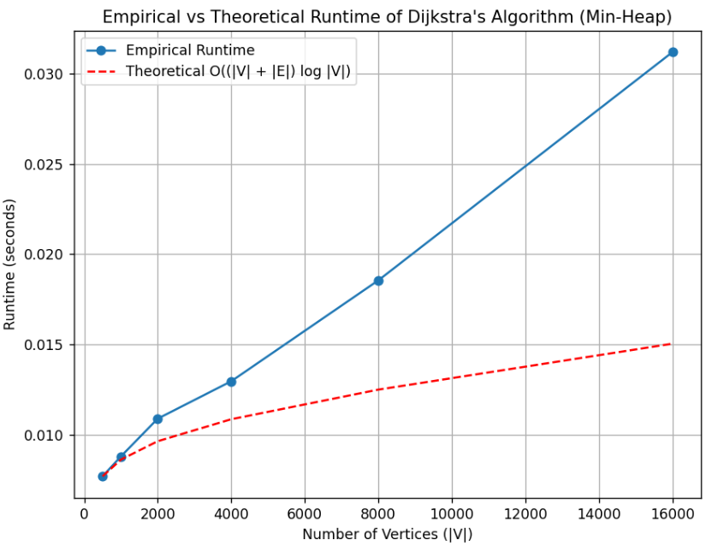
Empirical Graph analysis
Fixed |V|, Varying |E|
Fixed |E|, Varying |V|
O(E log (V))
O(V log (V))

Slide 21
Part (C)

Slide 22
Time complexities
Representation | Time Complexity | Best for
Adjacency matrix | O(V^2) | Dense graphs
Adjacency list | O((V+E) log V) | Sparse graphs

Slide 23
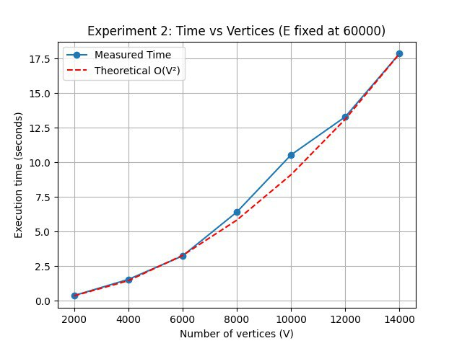
Varying v, fixed e
Matrix-Based
List-Based

Slide 24
Fixed V, Varying E
Matrix-Based
List-Based

Slide 25
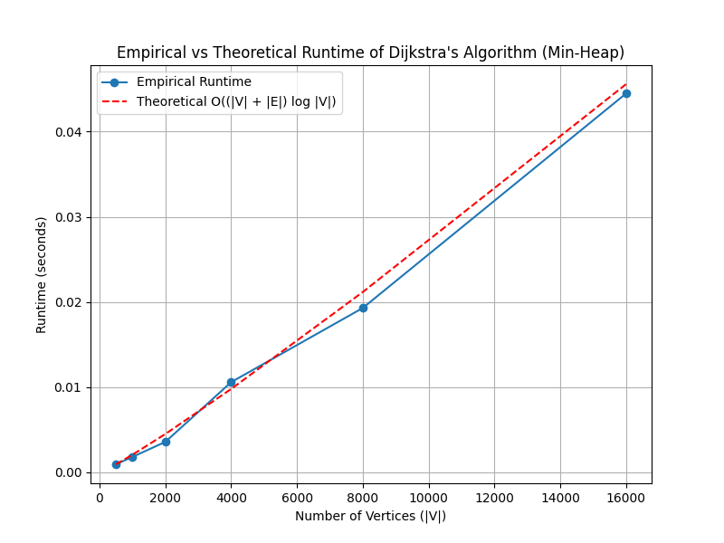
Varying E, Varying V
Matrix-based
List-based

Slide 26
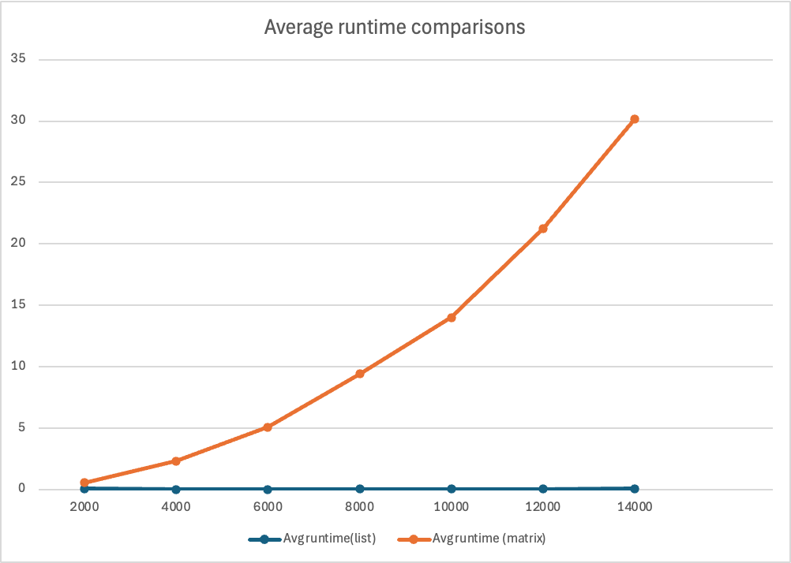
Empirical Comparison
Average runtime for adjacency list is significantly faster than that for adjacency matrix as it has fewer edges to compare
Adjacency matrix compares all possible edges
Adjacency list only compares existing edges
Notes:
In the adjacency list, min heap pushes the shortest distance vertex to the front, thus the algorithm does not have to loop through the entire list to find the shortest distance edge. Hence this leads to a faster runtime for adjacency lists. (Link to the next slide) --> This is also why adjacency list is perfect for sparse graphs and adjacency matrix is suitable for dense graphs on the other hand.
V range from 2000 – 14000, in intervals of 2000. E are multiples of 10 of V.

Slide 27
Comparison of implementations
Adjacency Matrix | Adjacency List
Simpler to implement | Slightly more complex due to heap operations
Performs reasonably for dense graphs | Overhead of log V makes it not as advantageous for very dense graphs
Poor for sparse graphs as too many checks wasted | More efficient for sparse graphs
Memory usage is large | Lower memory usage

